Slide 1
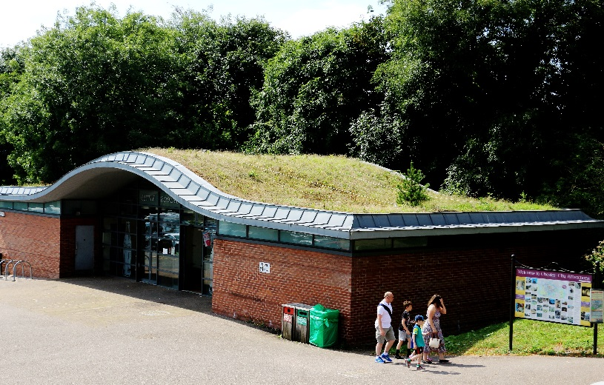
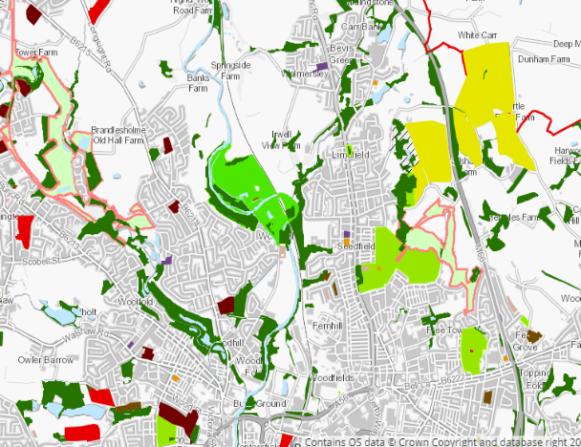

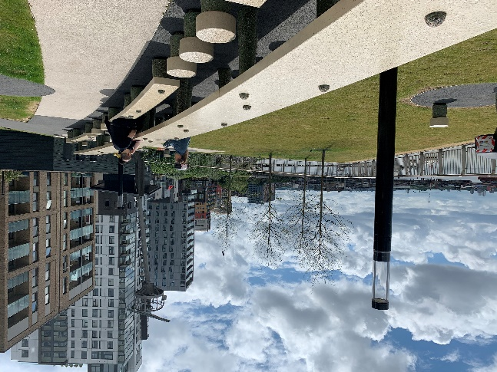
Green Infrastructure Framework -
Principles and Standards for England
Jane Houghton Senior Adviser, Project Manager, GI Framework, Natural England
April 2023
Notes:
Many thanks for inviting me this morning
I’m very pleased to join you to focus on GI and Climate change. in this presentation I’m going to talk through the new GI Framework of Principles and Standards for England and how it can help to achieve climate change mitigation and adaptation.
------------
As the environmental Improvement Plan says Climate change will impact on our ecosystems but we can only reach net zero with Nature-based Solutions. The GI approach of strategically planned environmental Improvement Plan says commitment to Take all possible action to mitigate climate change, while adapting to reduce its impact. multifunctional GI is fundamental to mitigating and adapting to climate change especially in our towns and cities.

Slide 2




What is Green Infrastructure?
Nature doing a job
“Green infrastructure: A network of multi-functional green and blue spaces and other natural features, urban and rural, which is capable of delivering a wide range of environmental, economic, health and wellbeing benefits for nature, climate, local and wider communities and prosperity”.
Healthier, more resilient Places
Healthier, more resilient People
Healthier, more resilient Economy
Healthier, more resilient Nature

Slide 3
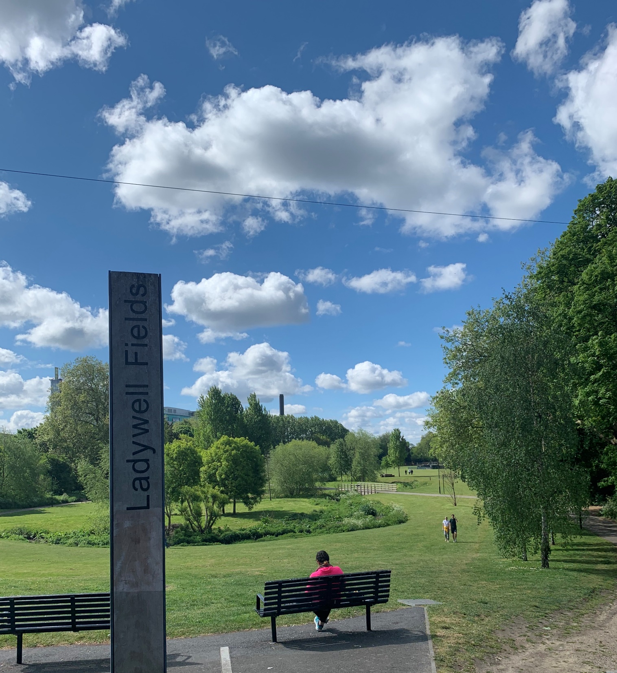
Aims
Improve existing and create more good quality green infrastructure for all its benefits
Everyone has access to good quality green infrastructure, particularly in areas of low income and health inequalities
Support Local Authorities in refresh of local plans
Mainstream Green Infrastructure as a key asset in creating and maintaining sustainable places
Credit: Julia Thrift
Will replace

Slide 4
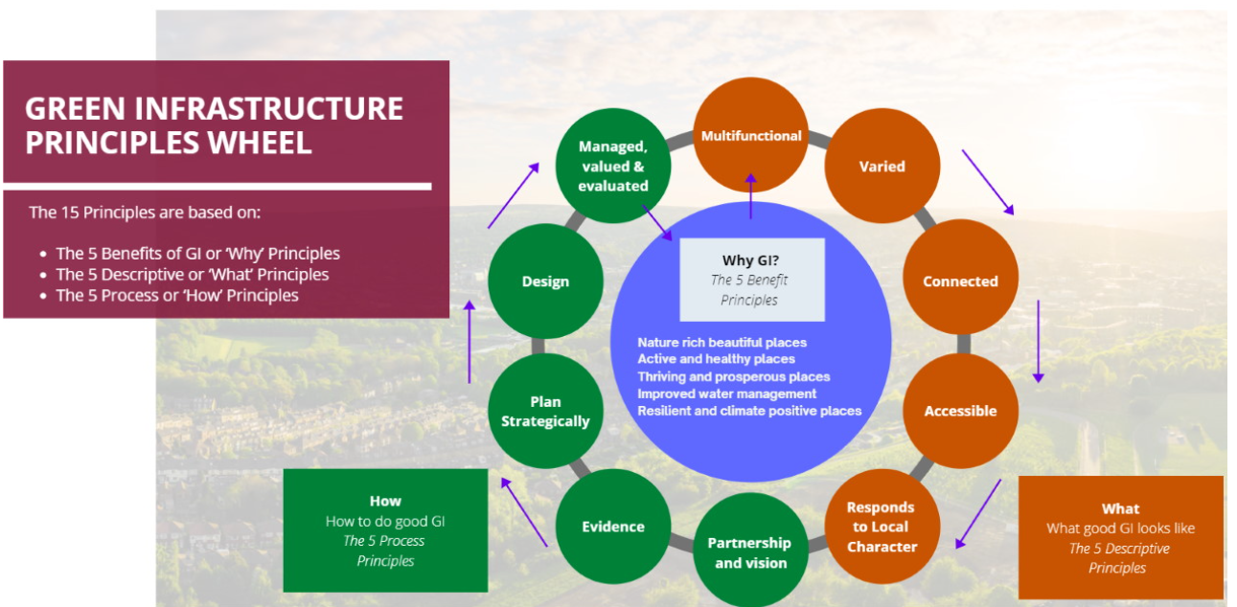
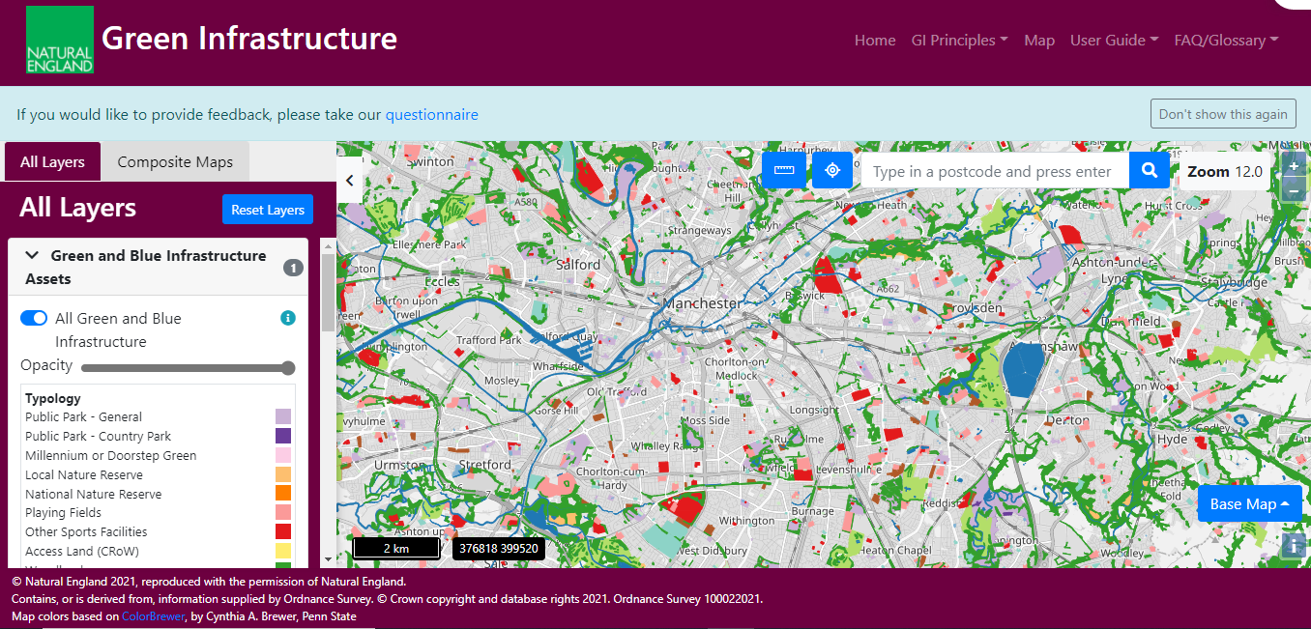
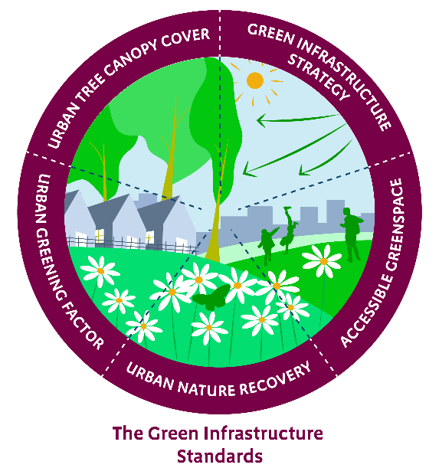
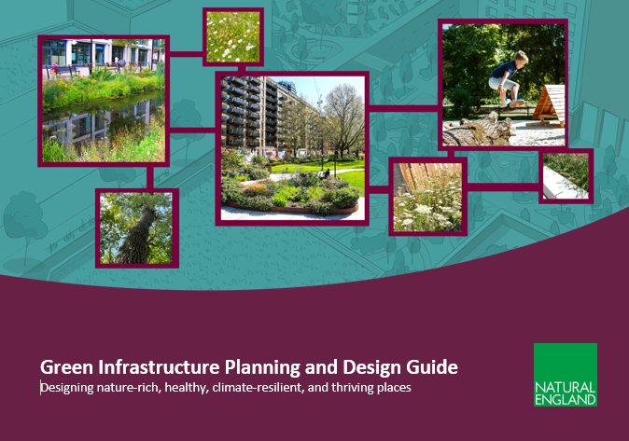
Green Infrastructure Framework
UPDATED
Green Infrastructure Principles
Green Infrastructure Mapping V1.2
Headline Green Infrastructure Standards
Green Infrastructure Planning and Design Guide
Process Journeys
NEW
Notes:
The GI Framework is a commitment in the 25 YEP.
We launched it in January, to an online audience of 3,700. The largest NE webinar to date
It aims to support LAs in the refresh of local plans, and mainstream GI as a key asset in creating and maintaining sustainable places.
The Framework development was overseen by a Cross Government Steering Group, and we engaged a 70 strong Advisory group throughout.
The Framework contains:
15 principles of good green infrastructure
A GI mapping database, which last year won a Government Geography award
5 headline Green Infrastructure Standards.
A Green Infrastructure planning and design guide
and finally the process journeys - step by step guides on applying the GI Framework.
Essentially we have an Greening Toolbox!
I’ll go into each component in a bit more depth

Slide 5
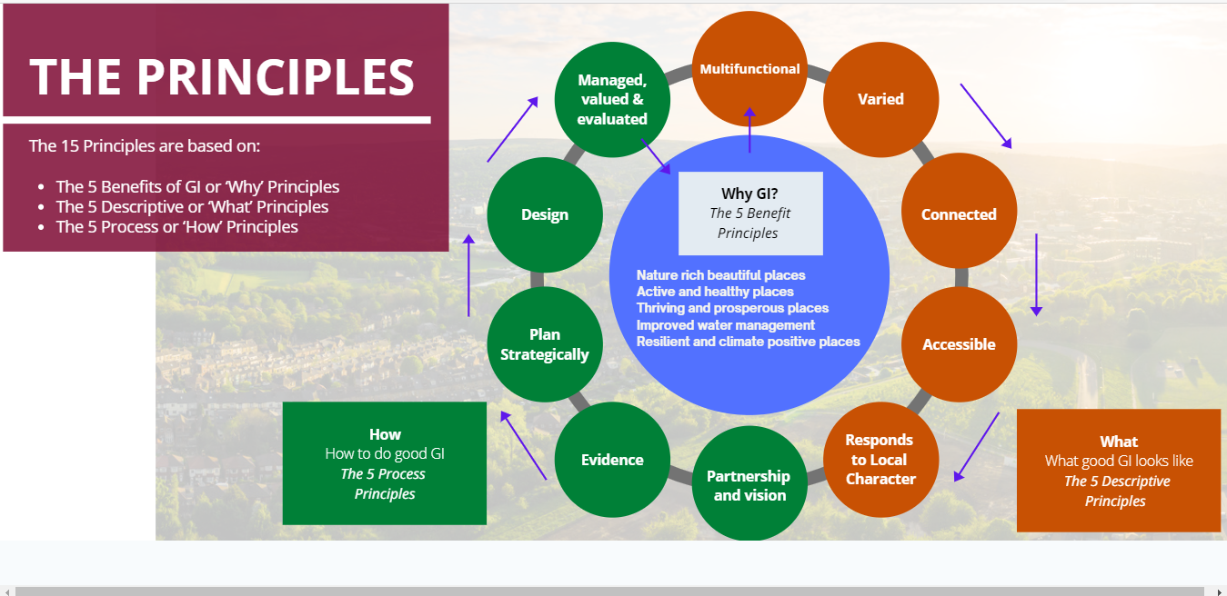
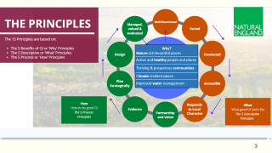
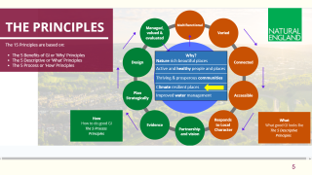
Green Infrastructure Principles
Why? Nature rich beautiful places
Active and healthy people and places
Thriving & prosperous communities
Climate resilient places
Improved water management
Notes:
The GI Principles are the golden thread setting out the why, what and how of good GI.
The framework aims to help deliver the 5 key GI benefits of nature, health and wellbeing, thriving communities, climate resilience, and improved water management. These benefits are set out in the 5 Why Principles in blue in the centre.
The Resilient and climate positive places principle, 4th down sets out that ‘GI makes places more resilient and adaptive to climate change and helps to meet zero carbon and air quality targets. GI itself should be designed to adapt to climate change to ensure long term resilience.’
There are 5 what Principles – in the orange circles describing what good GI Looks like
And 5 how or process principles in green

Slide 6

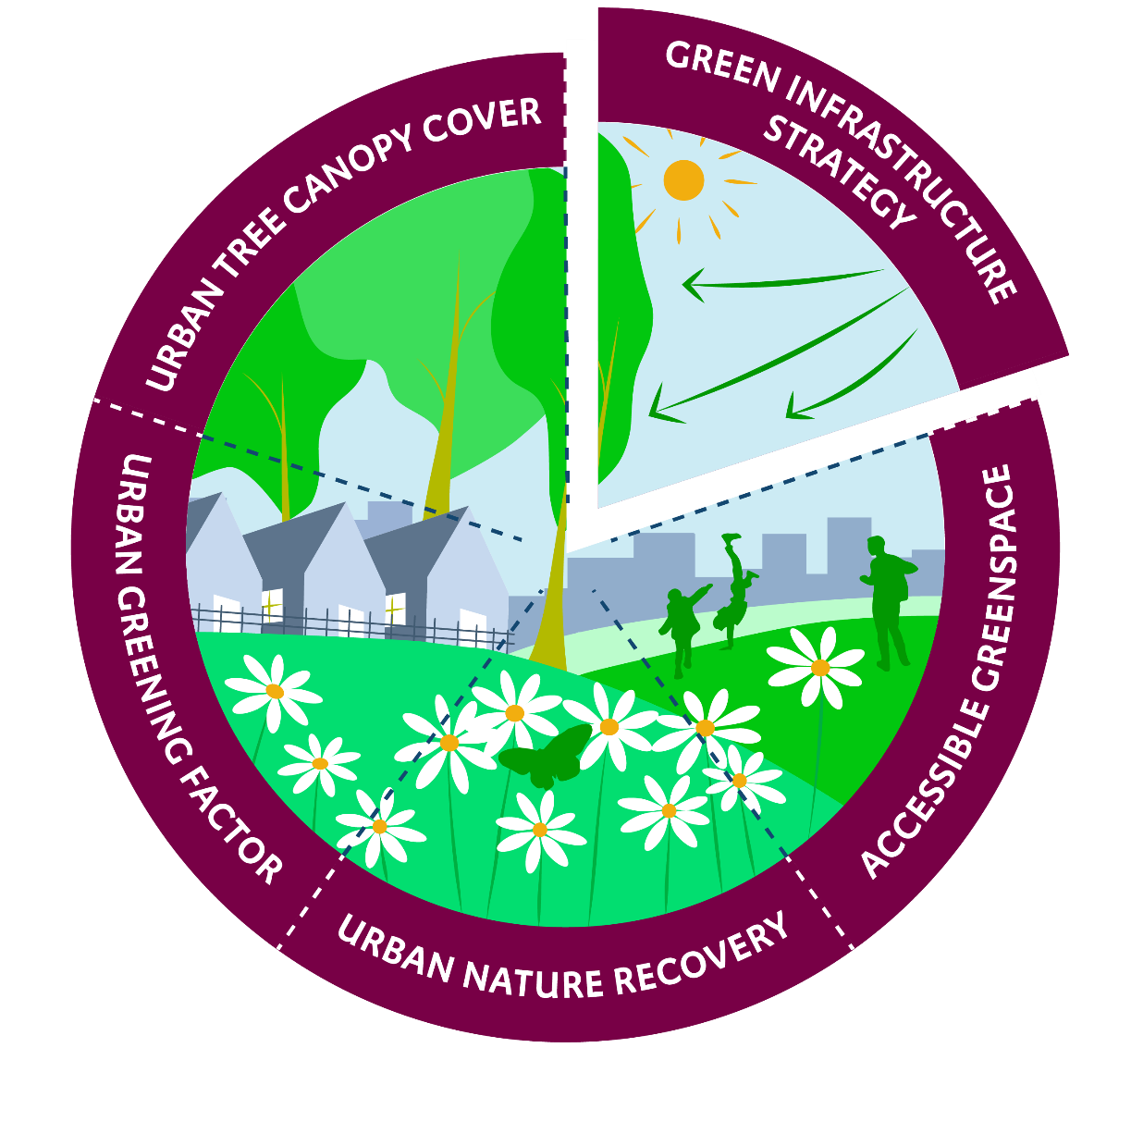




5 Headline Green Infrastructure Standards
1. Green Infrastructure Strategy Standard
2. Accessible Greenspace Standards
3. Urban Nature Recovery Standard
4. Urban Greening Factor Standard
5. Urban Tree Canopy Cover Standard
Notes:
This slide introduces the 5 Headline Green Infrastructure Standards.
These are voluntary Standards and they support the National Planning Policy Framework (NPPF) and will also complement mandatory mechanisms such as Biodiversity Net Gain (BNG) and Local Nature Recovery Strategies (LNRS) which form part of the Environment Act. The GI Standards are also referred to in the National Model Design Code.
The GI Framework includes a
S1. Green Infrastructure Strategy Standard
And Standards for
S2 Accessible Greenspace
S3 Urban Nature Recovery
S4 Urban Greening and
S5 Urban Tree Canopy Cover
I’ll talk through each of these.

Slide 7
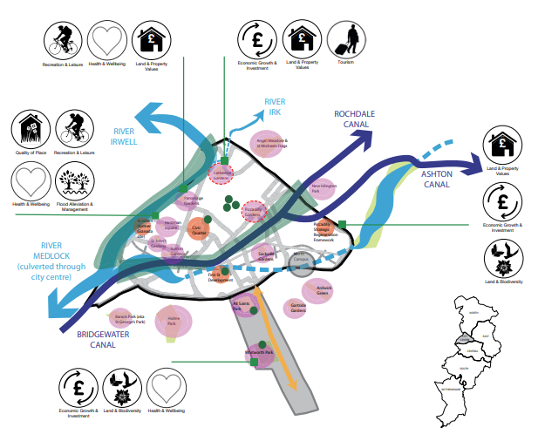
Green Infrastructure Strategy Standard
Headline Standard 1
Area-wide
Local Authorities in partnership with local communities, produce a Green Infrastructure Strategy and Delivery Plan applying the Green Infrastructure Principles and Standards locally
Major development
A Green Infrastructure Plan (can be part of a Design and Access Statement).
Manchester City Council
Notes:
The Green Infrastructure Strategy Standard supports the National Planning Policy Framework's policy that local authorities should develop strategic policies for Green Infrastructure.
This and the other Standards distinguish between the recommended levels of achievement when applied at an area wide scale, and for major developments.
At an area wide scale Local Authorities in partnership with local communities, should produce both a Green Infrastructure Strategy (or equivalent) and Delivery Plan that apply the GI Principles and Standards locally.
And Developers should also produce a Green Infrastructure Plan for their major developments.
------------------
We’re using the National Planning Policy framework definition of major new development
Doug McNab question Re slide 5, conscious this is all guidance (i.e. LPAs should….) – is there any possibility the government will strengthen the NPPF to require LPAs to develop GI strategies?
There are currently no plans to make the Green Infrastructure Standards mandatory. The Green Infrastructure Standards will support and work alongside mandatory approaches such as Biodiversity Net Gain, Local Nature Recovery Strategies and Local Design Codes. DLUHC is considering the role of the Green Infrastructure Framework in the context of Planning Reforms to be introduced through the Levelling Up and Regeneration Bill.
The Green Infrastructure Framework has already been incorporated into the National Model Design Code (Part 2 Guidance Notes). The purpose of the National Model Design Code is to provide detailed guidance on the preparation of design codes, guides and policies to promote successful design. Under Planning Reforms, it will become mandatory for all local planning authorities to prepare design guides or codes consistent with the principles set out in the National Design Guide and National Model Design Code, and which reflect local character and design preferences.
----
(Major housing development is where 10 or more homes will be provided, or the site has an area of 0.5 hectares or more.
For non-residential development it means additional floorspace of 1,000m² or more/or site of 1 ha or more,

Slide 8
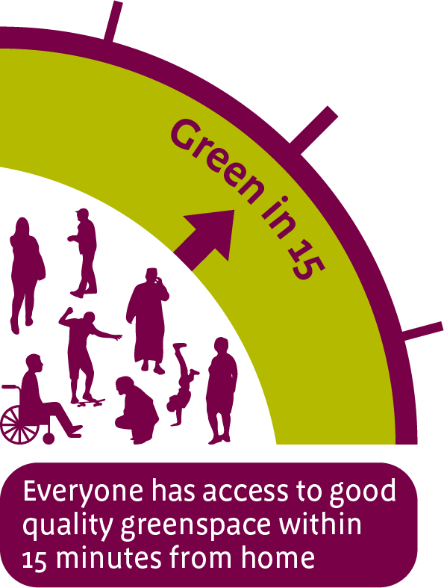
Accessible Greenspace Standards
Headline Standard 2
Area-wide
Everyone has access to good quality greenspaces within 15 minutes walk from home.
At least 3 hectares per 1000 population of publicly accessible greenspace
Accessible greenspace meets the Green Flag Award Criteria and best practice in accessibility for all
Major development
The local authority specifies the quantity, size and distance for accessible greenspace to be provided, based on the Accessible Greenspace Standards.
Notes:
So going on to Headline Standard 2, the Accessible Greenspace Standards. when we use the term greenspace this also includes blue space.
We’ve updated the Accessible Natural Greenspace Standards, and they say that as a minimum Everyone should have access to good quality greenspaces within 15 minutes walk from home. This aims to promote access and active travel to reduces CO2 and pollution. The standards also include minimum sizes and maximum travel distances to larger types of greenspaces such as district and country parks.
And there should be at least 3 hectares of publicly accessible greenspace per 1000 population; so a capacity standard;
And, in terms of quality, Accessible greenspaces should meet the Green Flag Award Criteria and be accessible for all, so that everyone can benefit.
For major developments, The local authority specifies the accessible greenspace to be provided within/ associated with the development,
--------------------------------
Suitable Alternative Natural Greenspace (SANGS - quality and type suitable to provide alternative greenspace to divert visitors from visiting sensitive sites such as Special Protection Areas (SPAs). Provide mitigation by preventing an increase in visitor pressure on the SPA. To achieve this, a higher standard than the Accessible Greenspace Standards (above) is often set, i.e. a SANGs Standard of 8 hectares per 1,000 head of new population.
Attractive cycling and walking networks as part of GI corridors can contribute to CO2 reduction by providing active travel options.

Slide 9
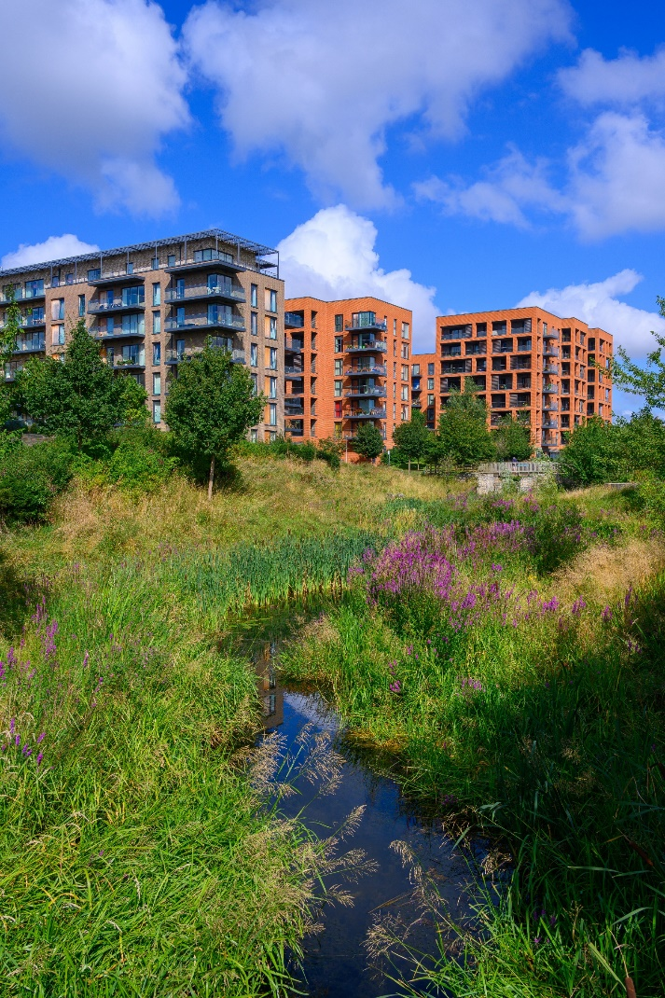
Urban Nature Recovery Standard
Headline Standard 3
Area-wide
In urban and urban fringe areas, green infrastructure for nature recovery is increased by an agreed %
Increase in the number and quality of Local Nature Reserves and Local Wildlife Sites
Major development
The developer identifies, in the Green Infrastructure Plan for the development (or in the Design and Access Statement), its contribution to nature recovery.
Credit: Berkeley Group
Notes:
The Urban Nature Recovery Standard says that local areas should
increase the proportion of urban and urban fringe green infrastructure that’s designed and managed for nature recovery
And Increase the number and quality of Local Nature Reserves and Local Wildlife Sites
For Major developments
The developer should identify its contribution to nature recovery, and include this in their Green Infrastructure Plan
------------
This will help GI contribute to the National Nature Recovery Network in urban areas and help local authorities to deliver their Biodiversity Duty, Biodiversity Net Gain and Local Nature Recovery Strategies.

Slide 10
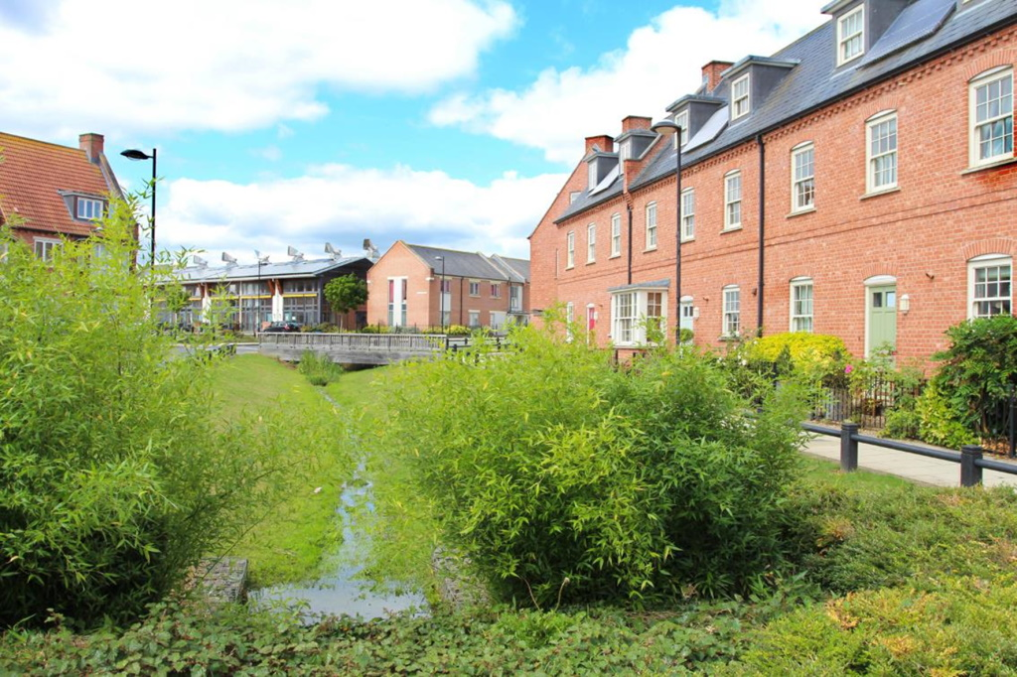
Urban Greening Factor Standard
Headline Standard 4
Area-wide
At least 40% average green cover in urban residential neighbourhoods.
No net loss of green cover in urban neighbourhoods
Major development
Urban Greening Factors of
    0.4 for residential
    0.3 for commercial
    0.5 for residential greenfield
User Guide: Urban Greening Factor for England User Guide.pdf (naturalengland.org.uk)
Photo: Peter Neal
Notes:
The Urban Greening Factor Standard aims to increase the level of greening and Green Infrastructure in developments and in urban environments more widely, to improve their resilience, sustainability and biodiversity.
By urban greening we mean the Vegetation ground cover, including trees, soil and water, and also green roofs and walls, as opposed to sealed man-made surfaces.
This standards says that there is should be least 40% average green cover in urban residential neighbourhoods,
And No net loss of green cover in urban neighbourhoods generally
For Major developments, we’ve developed a new national Urban Greening factor. This is a new type of Planning tool, and local planning authorities can adopt UGF policies that set a minimum Green Infrastructure score for planning approval, as shown here
------------------------

Slide 11

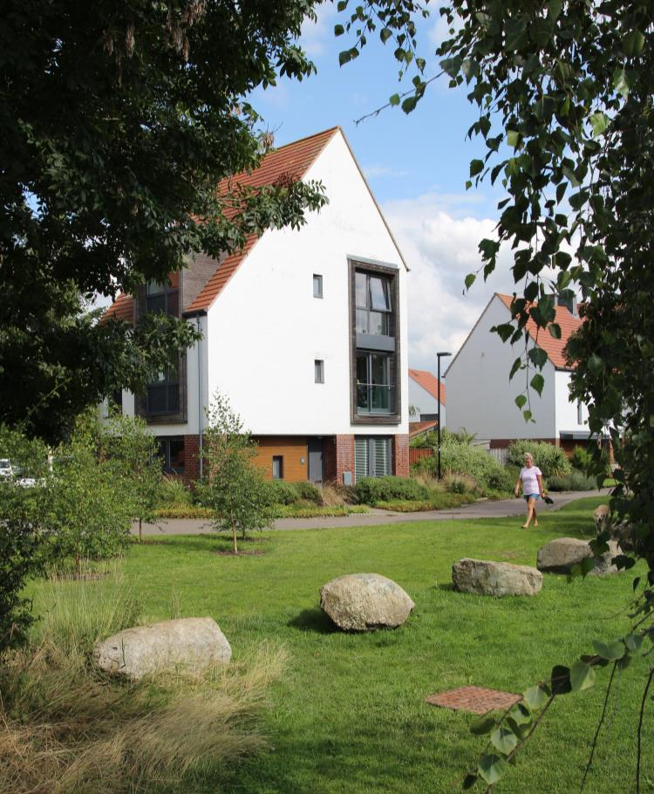
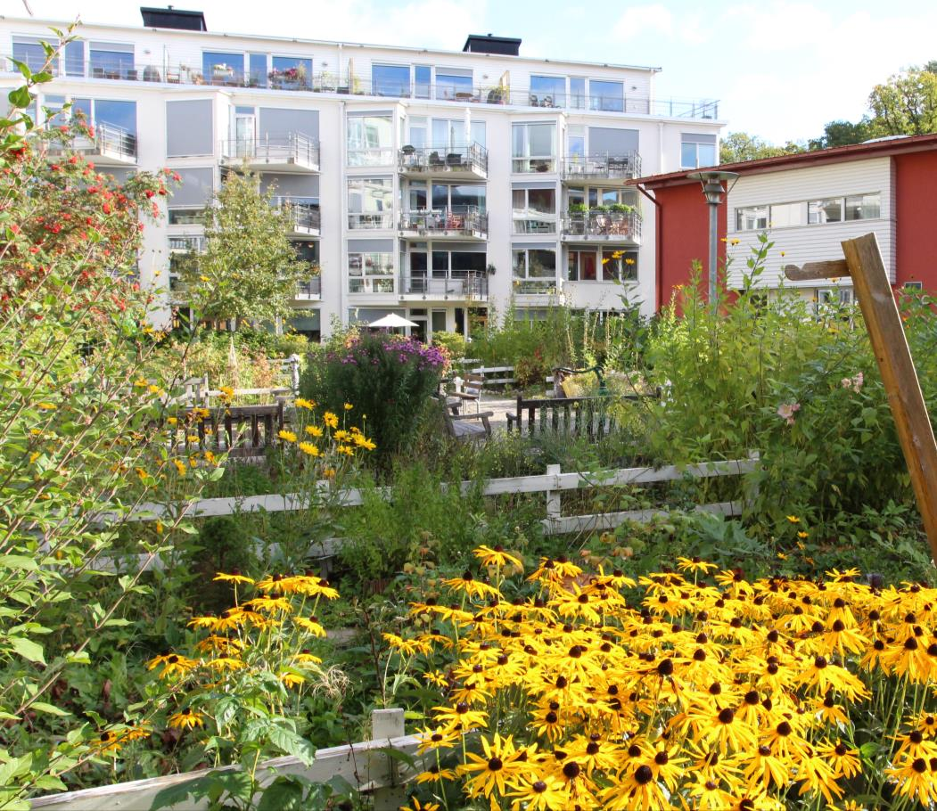
Urban Greening Factor - UGF - for England
UGF Core Components
1 - Target Score for Urban Greening
0.3 for predominately commercial development
0.4 for predominately residential development
0.5 for residential greenfield
2 - Weighed Surface Cover Types
Vegetation and Tree Planting
Green Roofs and Walls
SUDS and Water features
Paved Surfaces
Derwenthorpe, York
Hammarby Sjöstad, Stockholm
Notes:
The UGF can improve the resilience and sustainability of urban districts by increasing the delivery of ecosystem services including surface water management, air quality regulation and carbon sequestration,
The UGF is applied through a simple calculation to give a GI score reflecting the proportion and quality of GI in the development site
There are 2 components
Target scores for urban greening as we saw on the previous slide
Weighted surface cover types, in the 4 groups shown here. Each surface cover type is given a weighting called a factor according to its value for nature and the range of ES it delivers. Minimum 0 for sealed Man- made surface and maximum of 1 for semi-natural habitat.
----------
Applied to ‘Major Developments’ (Planning Act 2015)
Housing development - 10 dwellings or more, or where the area of the site is 0.5 hectares or more.
Other development - where the floor space is 1,000 square metres or more, or the site is 1.0 hectares or more.

Slide 12
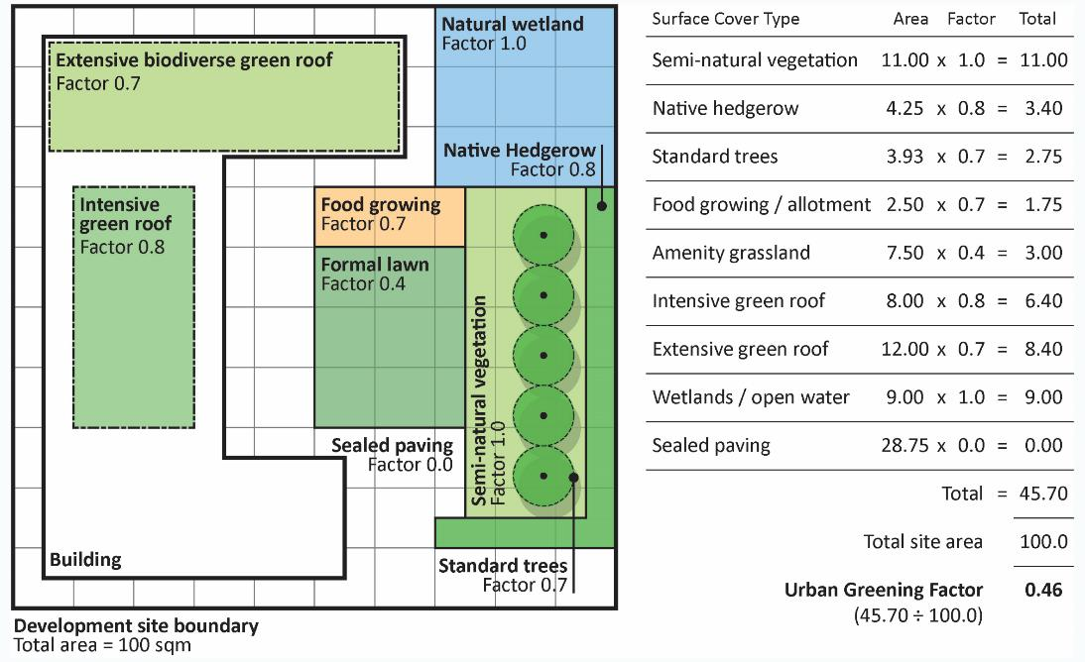
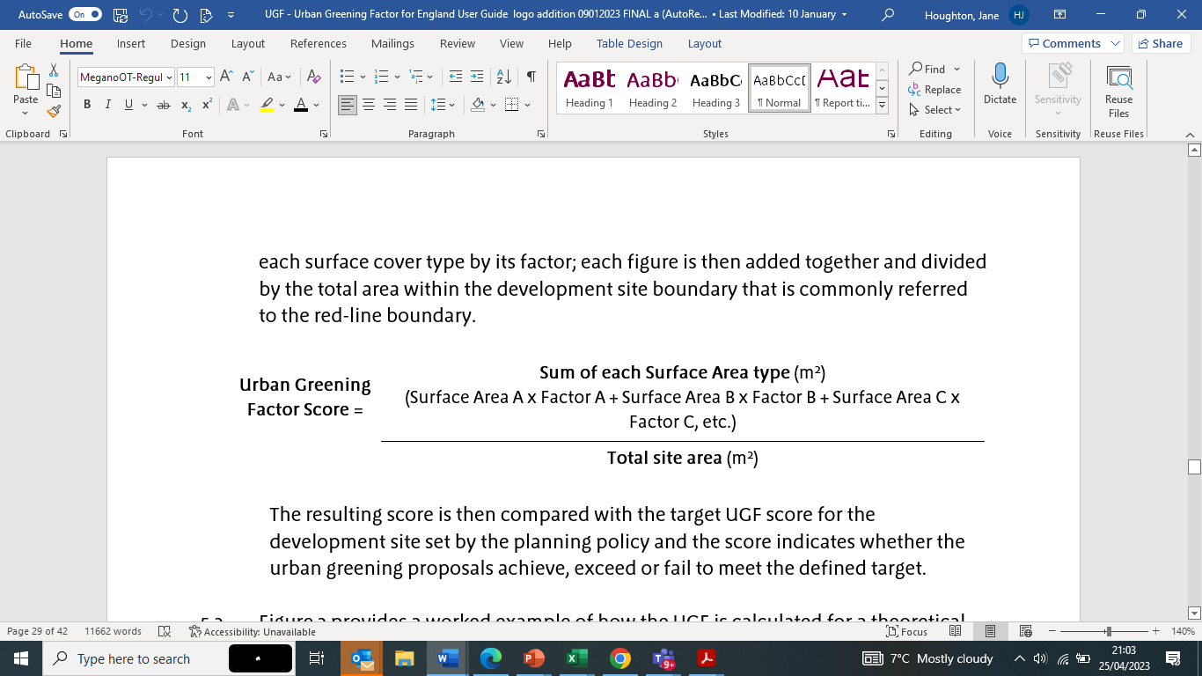
Calculating the UGF Score - Example of an UGF Calculation
Theoretical Development
Site Plan showing UGF factors
Total Area
100 sqm
Notes:
The UGF score for the development is calculated by multiplying the area of each surface cover type by its factor;
each figure is then added together and divided by the total area within the development site boundary .
The resulting score is then compared with the target UGF score for the development site, which has been set by the planning policy and the score indicates whether the urban greening proposals achieve, exceed or fail to meet the defined target.
This slide provides a worked example of how the UGF is calculated for a theoretical site.
It gives a UGF score of 0.46 – which would meet the target score NE recommends for residential developments

Slide 13
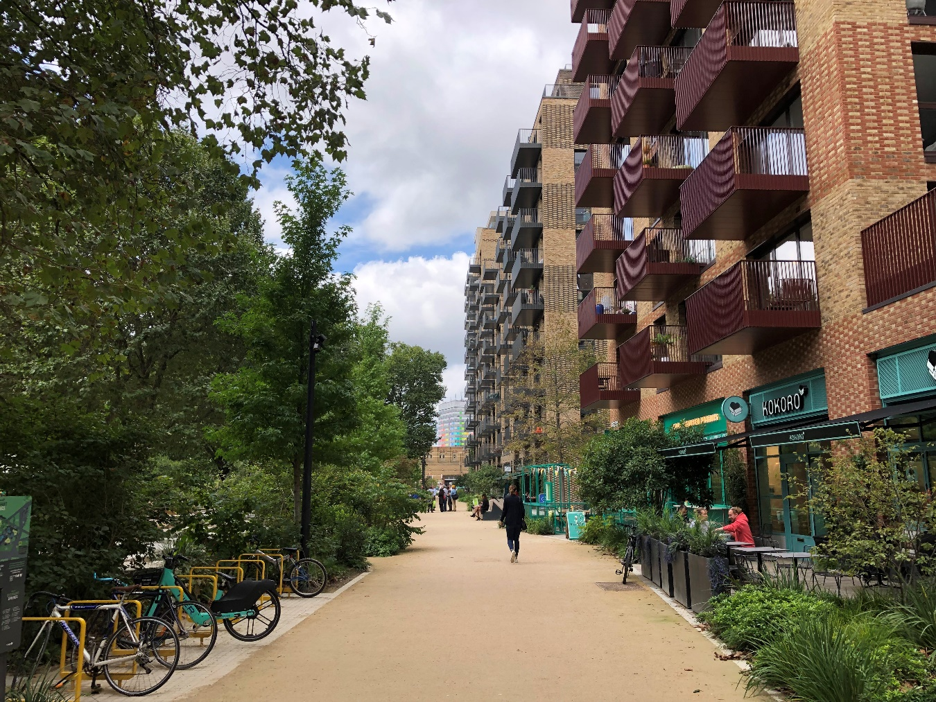
Urban Tree Canopy Cover Standard
Headline Standard 5
Area-wide
Urban Tree Canopy Cover is increased by an agreed percentage based on a locally defined baseline and taking into account local needs, opportunities and constraints
Major Development
Major development is designed to meet these targets
New and existing trees are incorporated into new developments and new streets are tree lined (in line with NPPF).
Notes:
Finally, the Urban Tree Canopy Cover Standard which we’re developing with the Forestry Commission.
This promotes an increase in tree cover for the many benefits that trees can provide in towns and cities such as
sequestering carbon;
providing shade and evapotranspiration that can help reduce daytime temperatures in urban areas, and provide health benefits by cooling during heat waves; and
slow down rainwater run off to help reduce flood risk.
At an Area-wide level the Local authorities should measure their baseline tree canopy cover and then set a target to increase it by an agreed percentage. The standard is in this form to respond to the wide variability in tree canopy cover in different places.
Major development should be designed to meet these tree canopy cover targets
New and existing trees should be incorporated into new developments and
new streets should be tree lined.
We’ll provide additional guidance e.g. on planting the right trees in the right places and biosecurity
--------------

Slide 14
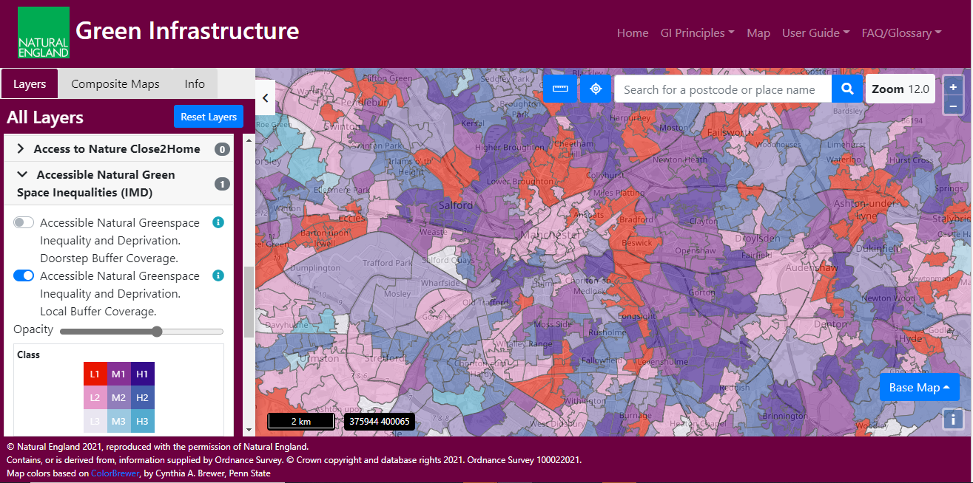
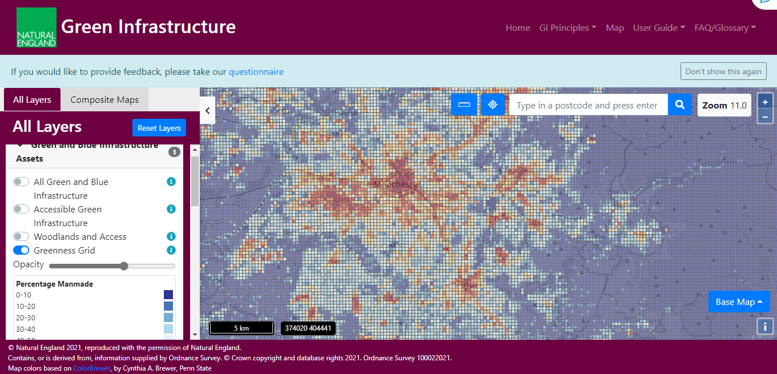
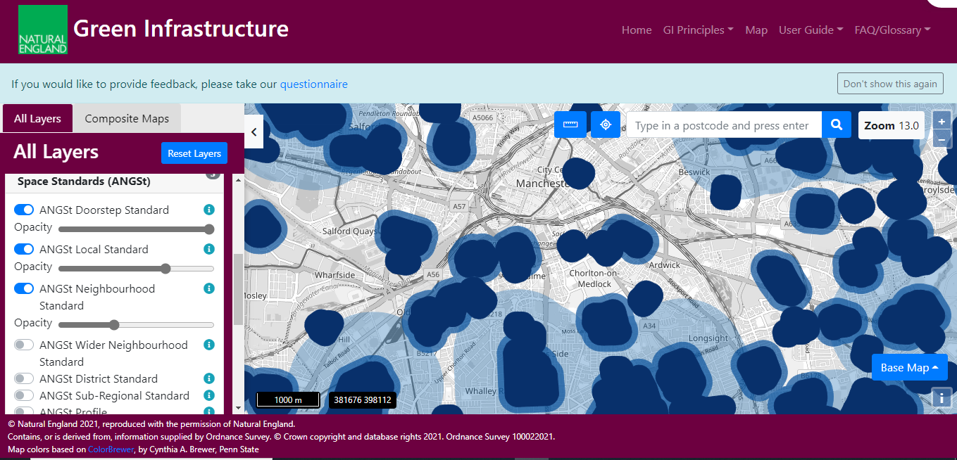
5
Green Infrastructure Mapping: How it can be used
https://designatedsites.naturalengland.org.uk/GreenInfrastructure/map.aspx
Where is the Green Infrastructure? (Standard 1)
Where do gaps matter most?
Who lives within 15 minutes of good quality green space? (Standard 2)
How green in your neighbourhood? (Standard 4)
Notes:
The Framework is supported by a Mapping Database of all green and blue infrastructure, which can be used in developing GI Strategies, and the data can be supplemented with local data.
It also provides an analysis of How green your neighbourhood is – the proportion of natural to man made surface at 250m grid squares – useful for standard 4 on urban greening.
And for accessible greenspace (Standard 2) – the mapping shows who lives within 15 minutes walk of greenspace - the white areas indicate gaps in greenspace provision
And finally where do these gaps matter most – for people in areas of high deprivation who may have a lack of private garden space. These gaps are the Red areas
Version 2 of the mapping is due for publication in December.
It will include significant new content – including …
Analysis based on Census 21 data
Urban Functionality and Needs Assessments – climate change focus.
Urban Habitat Maps
and new Health focussed content

Slide 15

Green Infrastructure Planning and Design Guide
Supports local authorities in developing design codes for green infrastructure
Complements the National Design Guide and National Model Design Code
Provides evidence for the functions provided by GI and practical advice for planning and designing good green infrastructure
Notes:
The fourth product is the GI Planning and Design Guide which
supports local authorities to develop design codes for green infrastructure
complements the National Design Guide and National Model Design Code.
Shows how GI can be designed to help to deliver the National Design Guide’s 10 characteristics of a well-designed place,
provides evidence for the functions provided by GI and practical advice for planning and designing good green infrastructure
It’s been written for local authority planners, but also useful for landscape architects, urban designers, greenspace managers and wider stakeholders
It draws out the links with Biodiversity Net Gain and Local Nature Recovery Strategies and how GI can contribute to delivery of BNG.

Slide 16
Process Journeys - guides
Step-by-step Guides - for different audiences to help policy making, strategy and delivery of the GI Standards at local level. For:
Local Planning Authorities - developing Green Infrastructure Strategies and Policies
Developers and Design Teams - Incorporating Green Infrastructure into Development
Neighbourhood Planning Groups - Incorporating Green Infrastructure into Neighbourhood Plans
Partnership and Vision
Evidence
Planning Strategically and developing GI Policy
Integrating the GI Strategy
Managing, Valuing, Monitoring and Evaluating GI
Notes:
And finally the Process Journeys. These are best practice guides on how different stakeholder groups can take a strategic approach to GI .
There are 3 step by step process journeys, for:
Local Planning Authorities to develop GI Strategies and policies
Developers and Design teams to incorporate GI into development
And for Neighbourhood Planning Groups.

Slide 17
https://designatedsites.naturalengland.org.uk/GreenInfrastructure/Home.aspx
Notes:
Many thanks

Slide 18
SPARE SLIDES BELOW THIS

Slide 19
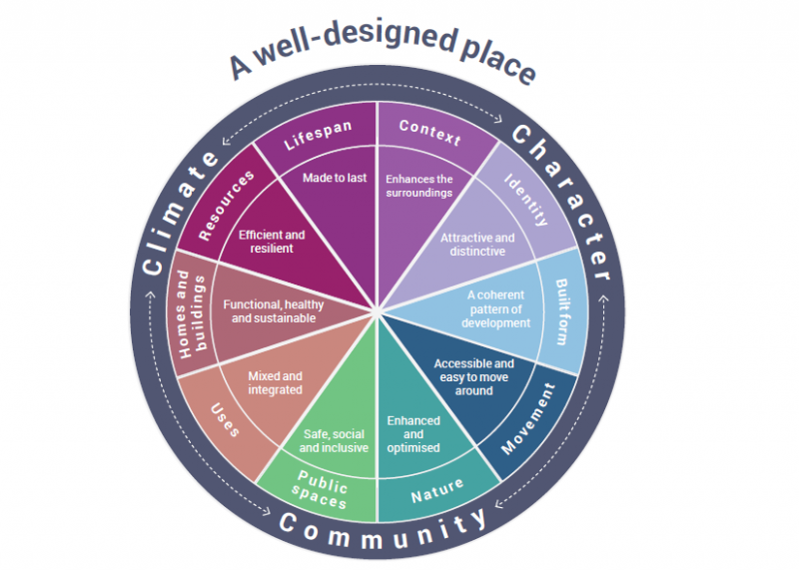
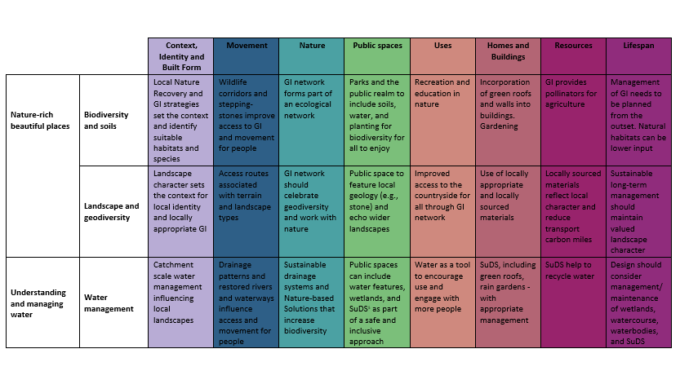
Green Infrastructure Planning and Design Guide
How to apply the GI Framework including:
  Principles (Why, What & How)
  Standards (GI Strategy, Accessible Greenspace, Urban Nature Recovery, Urban Greening Factor, Urban Tree Canopy Cover)
Designed to work with the three-step process in National Model Design Code: Baseline analysis, Vision, Coding.
Matrix showing the National Design Guide’s 10 characteristics of a well-designed place, and how green infrastructure can be designed in to deliver for each characteristic.
Notes:
It shows
How to apply the GI Framework including:
Principles (Why, What & How)
Standards (GI Strategy, Accessible Greenspace, Urban Nature Recovery, Urban Greening Factor, Urban Tree Canopy Cover)
Designed to work with the three-step process in National Model Design Code: 1. Baseline analysis, 2. Vision, 3. Coding.
Its designed to work with National Design Guide’s 10 characteristics of a well-designed place (the circular diagram) and the Matrix in the bottom right here shows how green infrastructure can be designed in to deliver each characteristic.

