Slide 1

The Durham Coast Story
Outdoor Recreation Network
Workshop 31st July 2018
Niall Benson www.durhamheritagecoast.org Heritage Coast Officer
@DurhamCoast

Slide 2
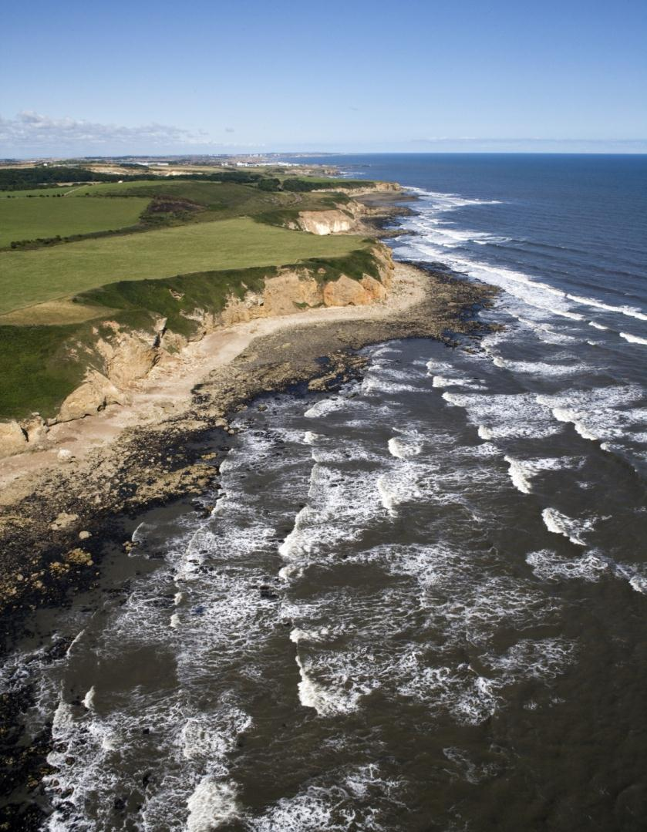
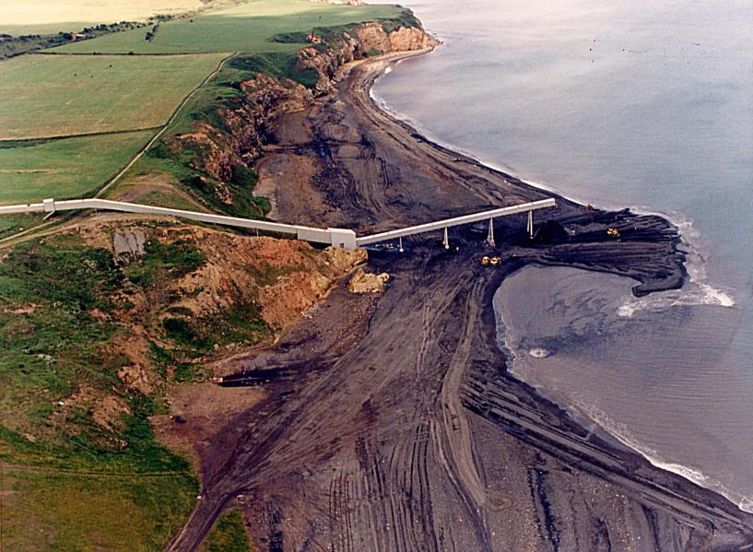
Before and After
2010
1992

Slide 3

Strategic Tools
Partnership
      Initially proven for delivery but not management
      Voluntary
Heritage Coast status
    Non statutory definition, voluntary
    Includes coastal waters
    Missed out of Countryside and Rights of Way Act?
Management Plan
    Key document – complicated
    Business Plan - delivery focus
Success
    Always useful

Slide 4
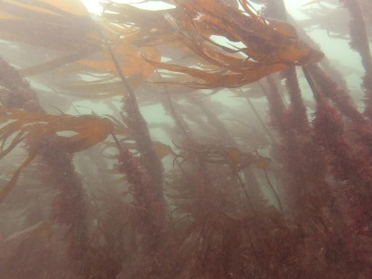
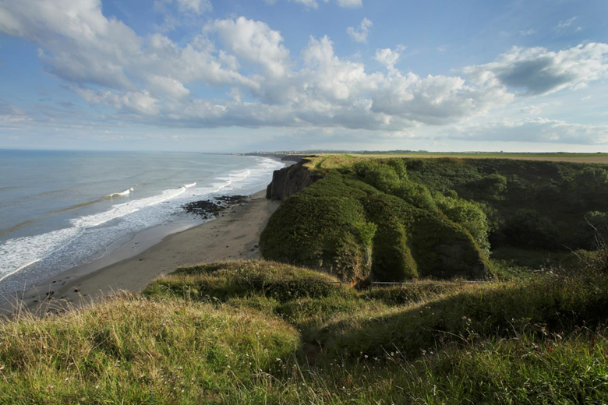
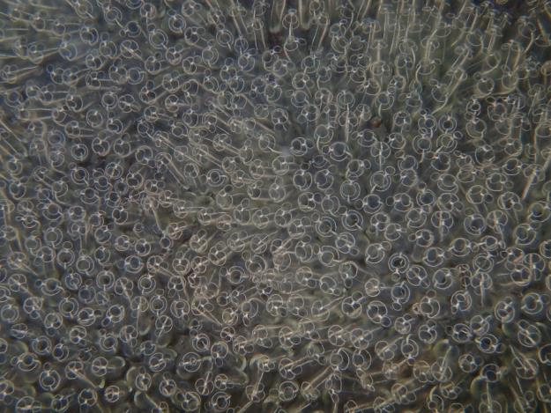
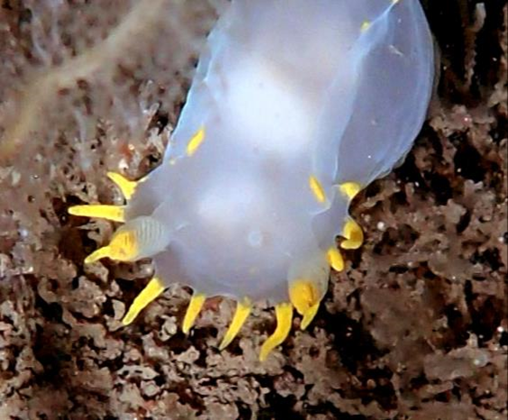

Visible Delivery
Images: Paula Lightfoot – Seasearch
Truly appreciated

Slide 5
What is “seascape”?
‘An area of sea, coastline and land, whose character results from the actions and interactions of land and sea, by natural and/or human factors.’
‘An area of distinct character’
From European Landscape Convention

Slide 6
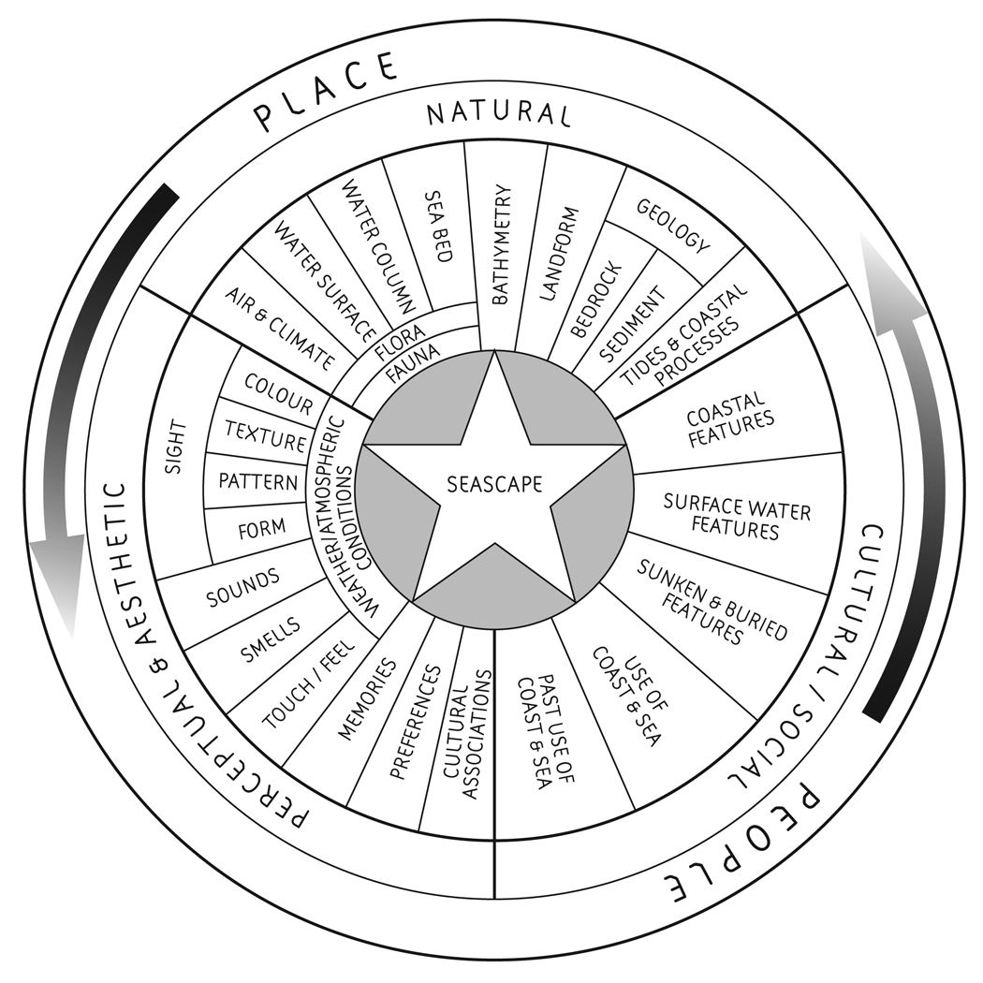
NB Thanks to Christine Tudor NE

Slide 7
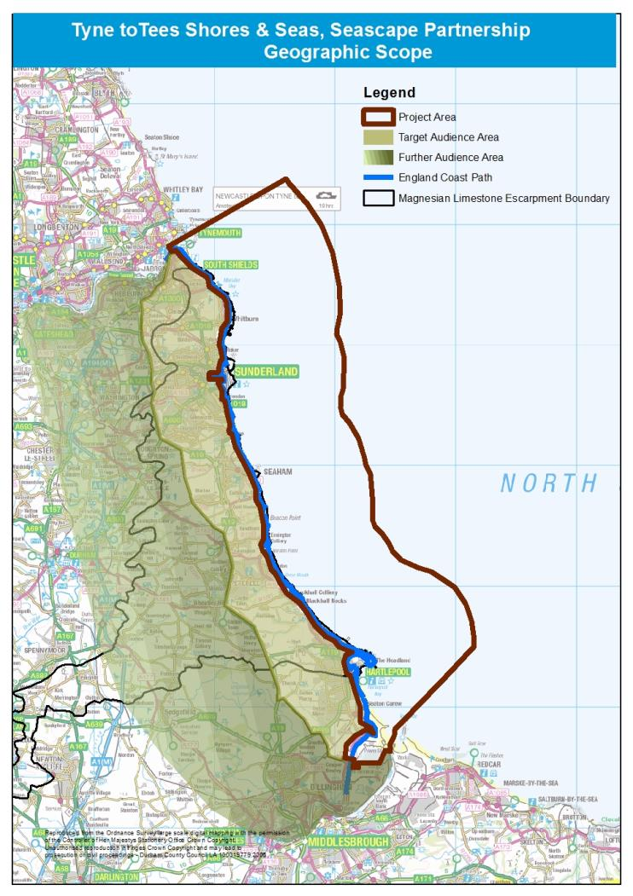
Magnesian Limestone Coast

Slide 8


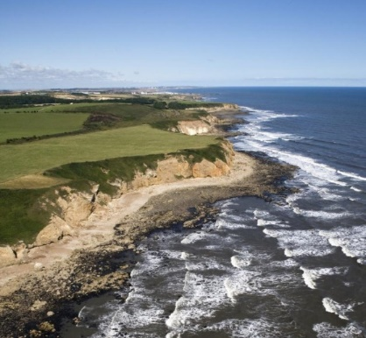
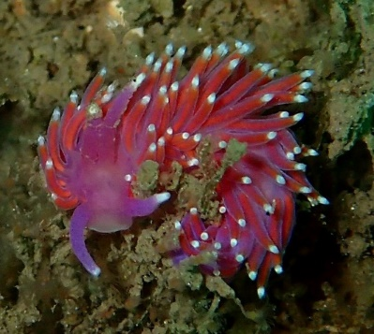
Tyne to Tees Shores and Seas
A Seascape Partnership
Heritage rich Seascape
Common geology
  Magnesian limestone
Common industrial past
  Mining, shipbuilding, trade
Common wartime experience
  East Coast War Channels
Common culture
  Post industrial society
Common natural features
  Coast & marine fauna and flora
But often overlooked
Most visitors come from within 6km
Forgotten between North Yorkshire & Northumberland
Time to write the next chapter…

Slide 9
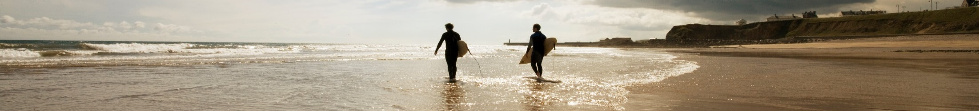
What and How?
Builds on:
North East Marine Planning process
Sunderland Tall Ships 2018
England Coast Path partnership
Ambition
Heritage, whether built, cultural or natural, will be better recorded, better managed and in better condition
Coastal communities are better engaged with their rich heritage and can better access the amazing coast on their doorstep
£5 million over 6 years
Evidence base for future coastal and marine policy for England
Proposed Projects:
  From shorebirds to shipwrecks e.g.
  Hartlepool’s high and low lights
  Wreck, water & shore activities
  Volunteer training & citizen science
  Beach Care & Blue Gym
  Seascape “Stations
  More as project progresses

Slide 10

Heritage Lottery Fund Landscape Partnerships Funding Programme
Partnership of organisations
Develop a scheme of projects £100,000 to £3,000,000
To enhance natural, built and cultural heritage
Working at landscape scale
For the benefit of heritage and the communities it shapes
Can also be applied to seascapes…

Slide 11

Our Timescales
Stage 1 bid – May 2017
Approved 10/17
18 month development phase - £247,690
Stage 2 submission – July 2019
For approval
Delivery January 2020 – January 2024
4 year delivery phase £4,801,695

Slide 12
Our Ambition
Heritage, whether built, cultural or natural, will be better recorded, better managed and in better condition.
Coastal communities are better engaged with their rich heritage and can better access the amazing coast on their doorstep.

Slide 13
Themes
1: Seascape over Time
Telling the incredible story from Zechstein Sea, through ice ages, wars and industrial history up to the present day
2: Revealing Hidden Heritage
Using innovative methods and participative approaches engaging beyond our usual audiences
3: Accessing the Sea
Improving access, removing barriers and allowing local communities to make full use of our coastal and marine assets
4: Coastal Champions
Opportunities for learning, training and enjoyment engendering a stewardship of this unique seascape for generations to come

Slide 14
Thank you for listening
Feel free to contact me with any questions at any time
E: Niall.benson@durham.gov.uk
T: 03000 268130

