Slide 1
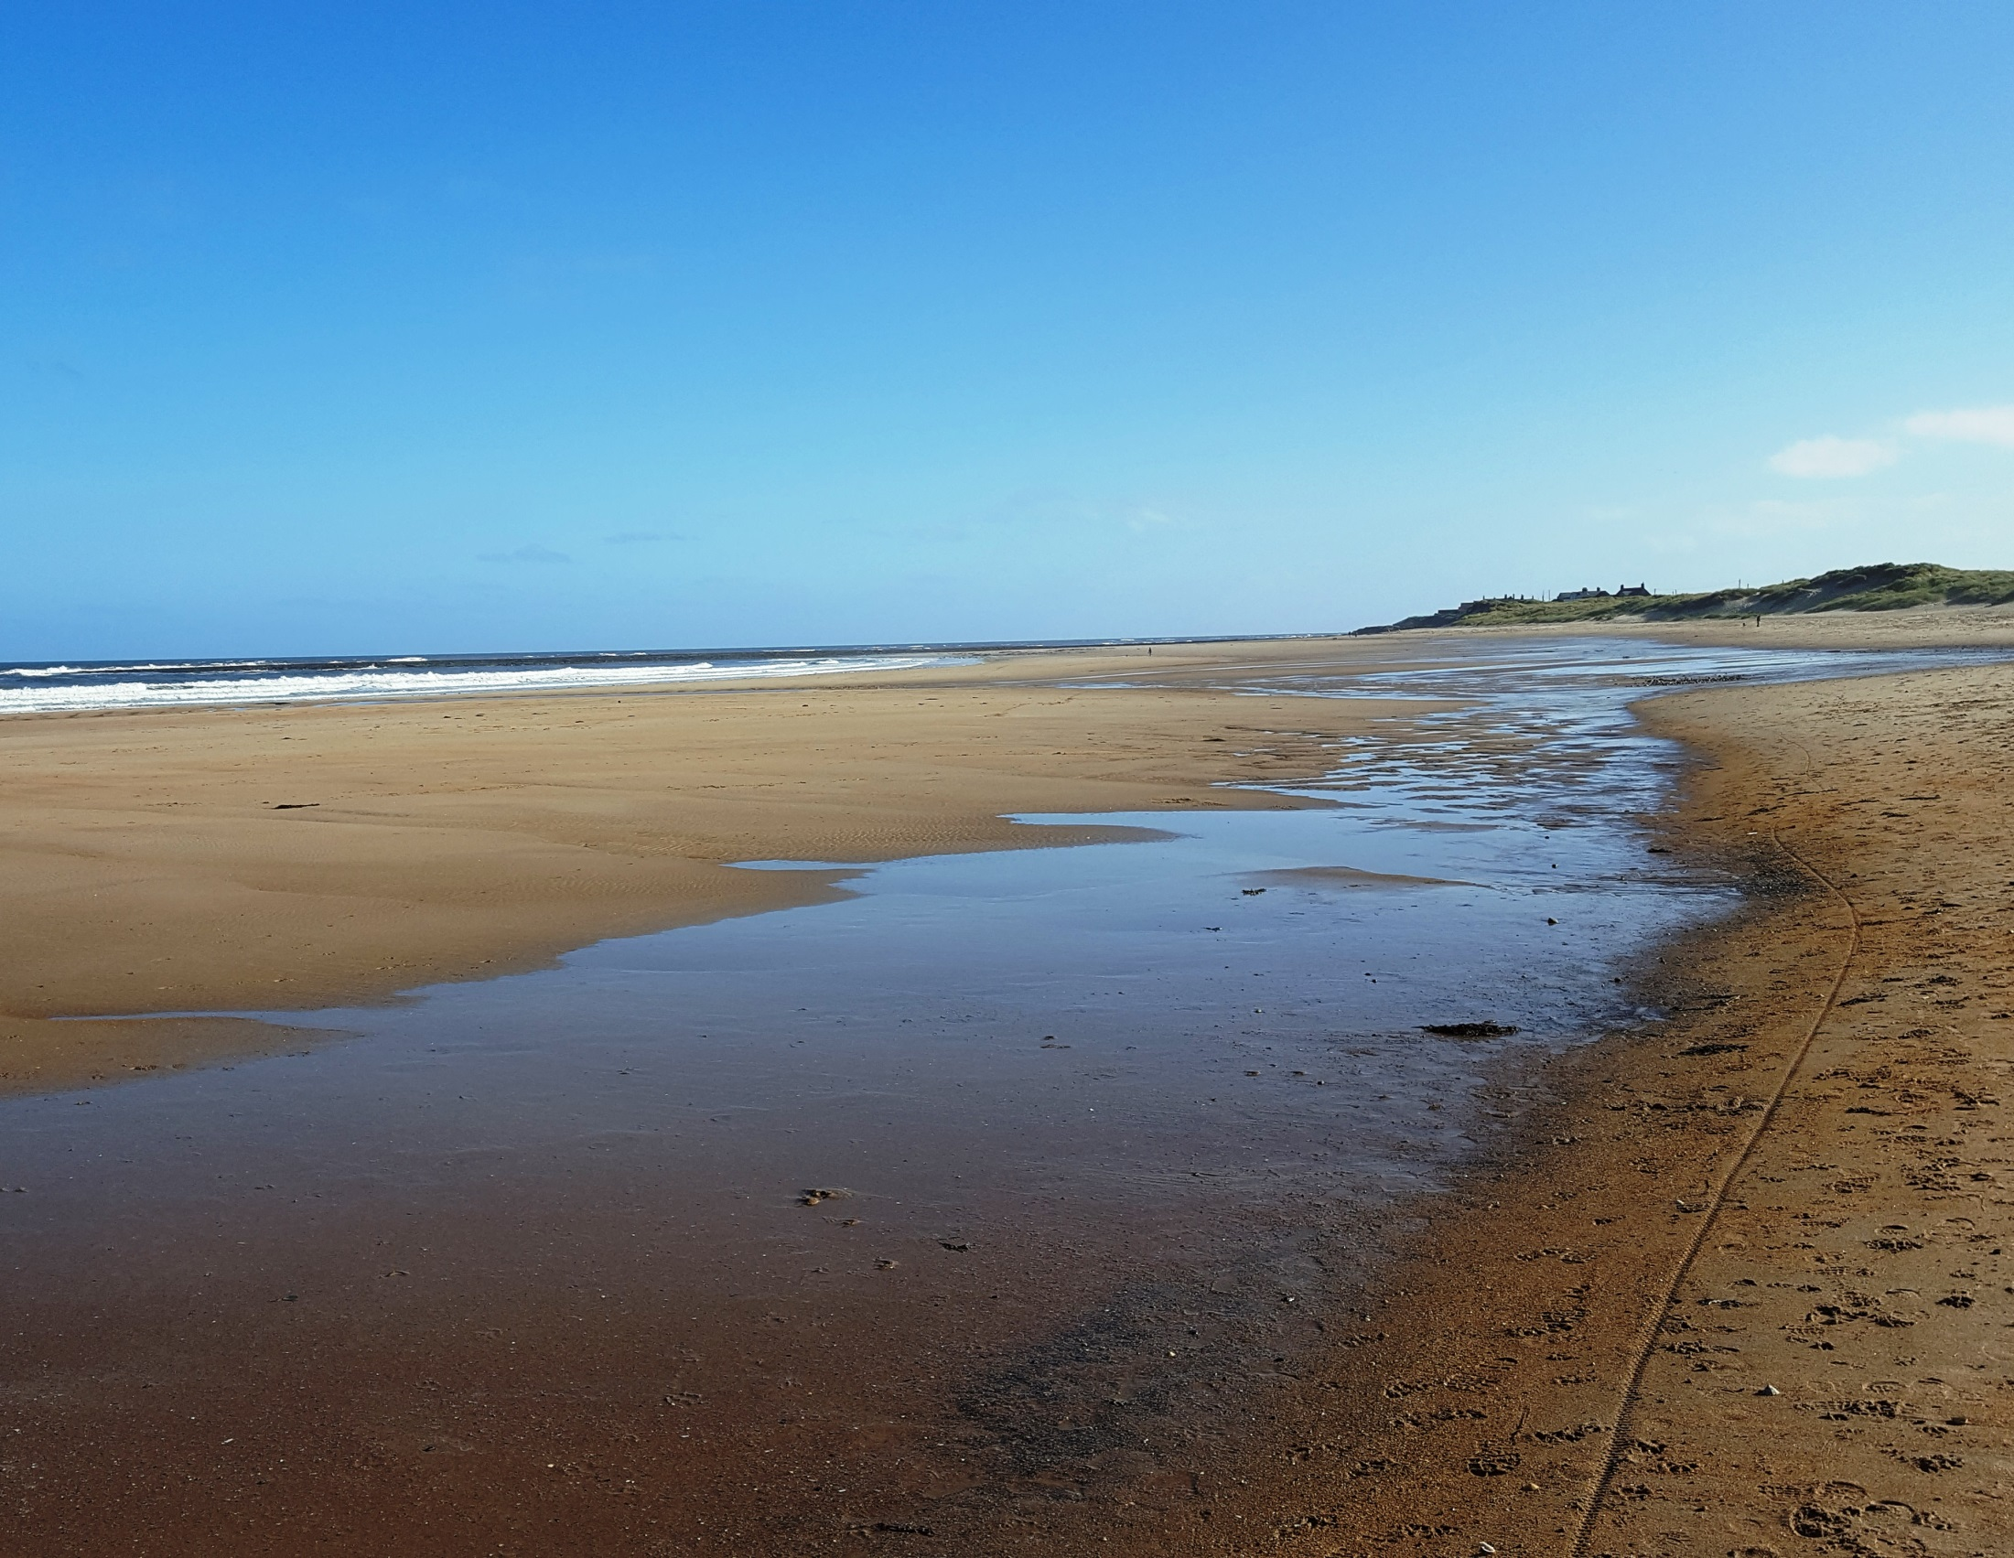
England Coast Path
Martin Shaw
Senior Advisor ECP National Team
How we got here
Plans to complete
Benefits emerging

Slide 2
So what is the England Coast Path?
The Marine and Coastal Access Act 2009, (Part 9) establishes the coastal access duty - to create a long-distance walking route around the English coast, and to identify land beside it, the coastal margin, which should be accessible to the public on foot.
In discharging this duty we follow statutory guidance – the Coastal Access Scheme.
This sets out an approach, which includes a statutory objections process, ensures that a balance is struck between the interests of those who own the land and the public in having new access rights over the land.
It also enables us to respond to coastal change (‘roll back’) and ensures protection of the natural environment.

Slide 3
“I’m pleased to announce today that the government will be putting the funding in place to ensure the path is completed by 2020.”
DPM 3rd September 2014

Slide 4
We are all working to a detailed Programme Plan signed off by Defra and Cabinet Office which sets out the delivery of some 66 stretches over five years to meet the 2020 target.

Slide 5
The nature of the coastal access rights
i.e. foreshore, beach, dune, flat, cliff, bank and barriers
Certain coastal
land types
Trail
The Coastal Margin
Land seaward of the trail (unless ‘excepted’ land e.g. Buildings and their curtilage)
Land landward of the trail (discretionary)

Slide 6
The nature of the coastal access rights - excepted land
Excepted in full
buildings, their curtilage, parks and gardens:
land used for the purposes of a railway, racecourse or aerodrome;
land used for statutory undertaking, although not flood defences;
school playing field or associated land;
land in use for mineral extraction;
MOD land subject to byelaw; and
land which is, or forms part of, a highway.
Excepted, but legislation allows for a route (only) to be proposed:
arable land;
golf course;
a regulated caravan or camping site; and
burial grounds.

Slide 7
The nature of the coastal access rights - balancing public & private interests
Public interest
Private interest
Proximity of the trail to the sea
Views of the sea from the trail
Safety and convenience
Continuity of the trail
Operational needs
Income
Privacy
Changes of use
Enjoyment and protection of the natural environment
Responsiveness to coastal change – ‘roll back’

Slide 8
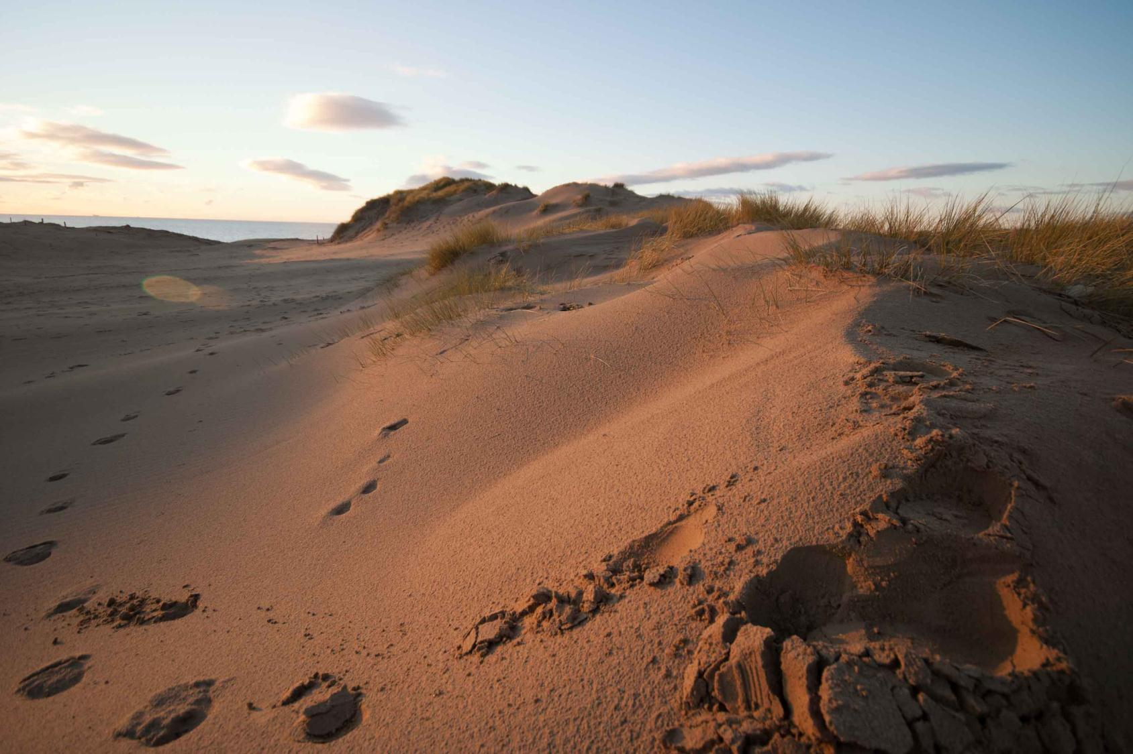
The 5 stages of delivery
Prepare
Sensitivities, extent of existing access, Key locations
Develop
Contact with owners, Meetings, ‘Walk the course’
Propose
Publish our report,
Determine
receive any objections, SoS approves in the light of any objections
Open
Establishment and launch.

Slide 9
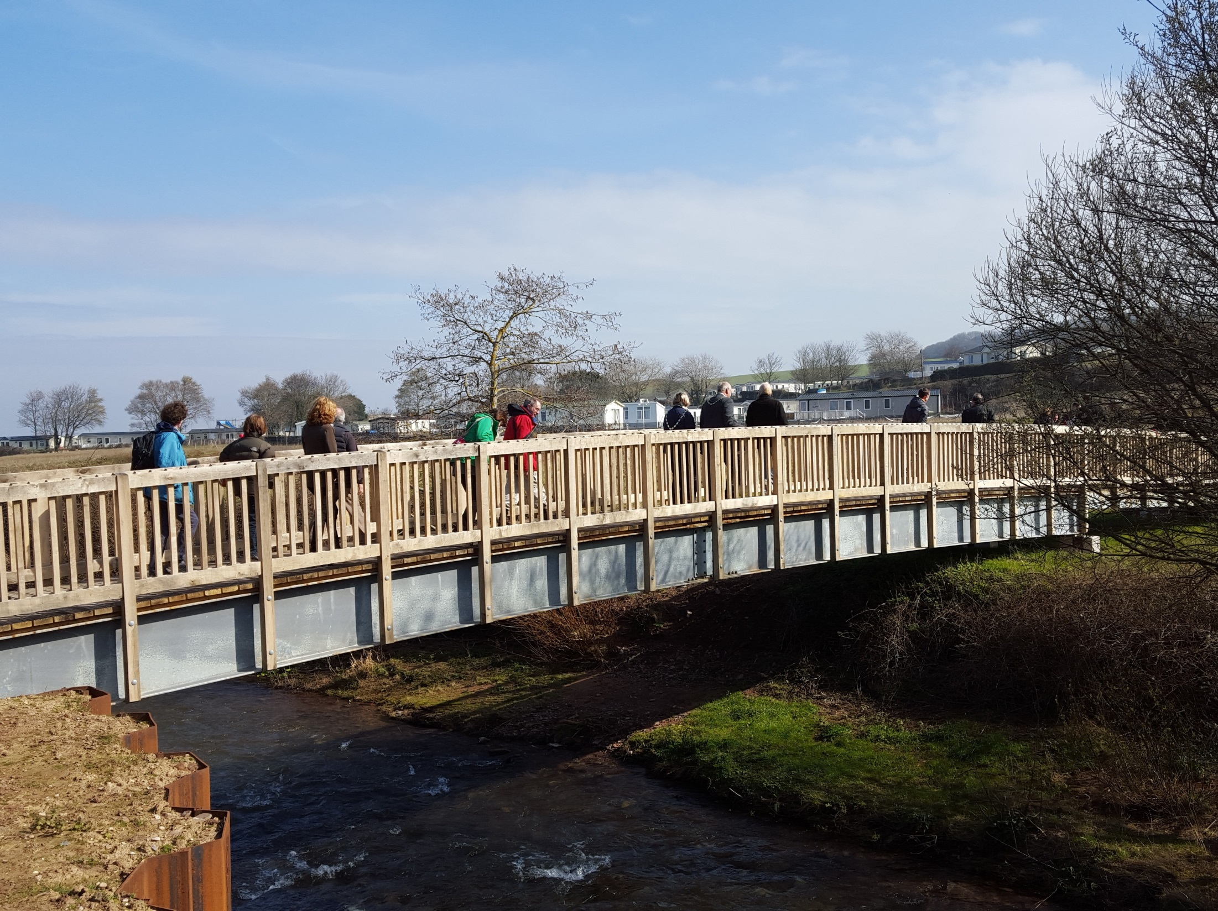
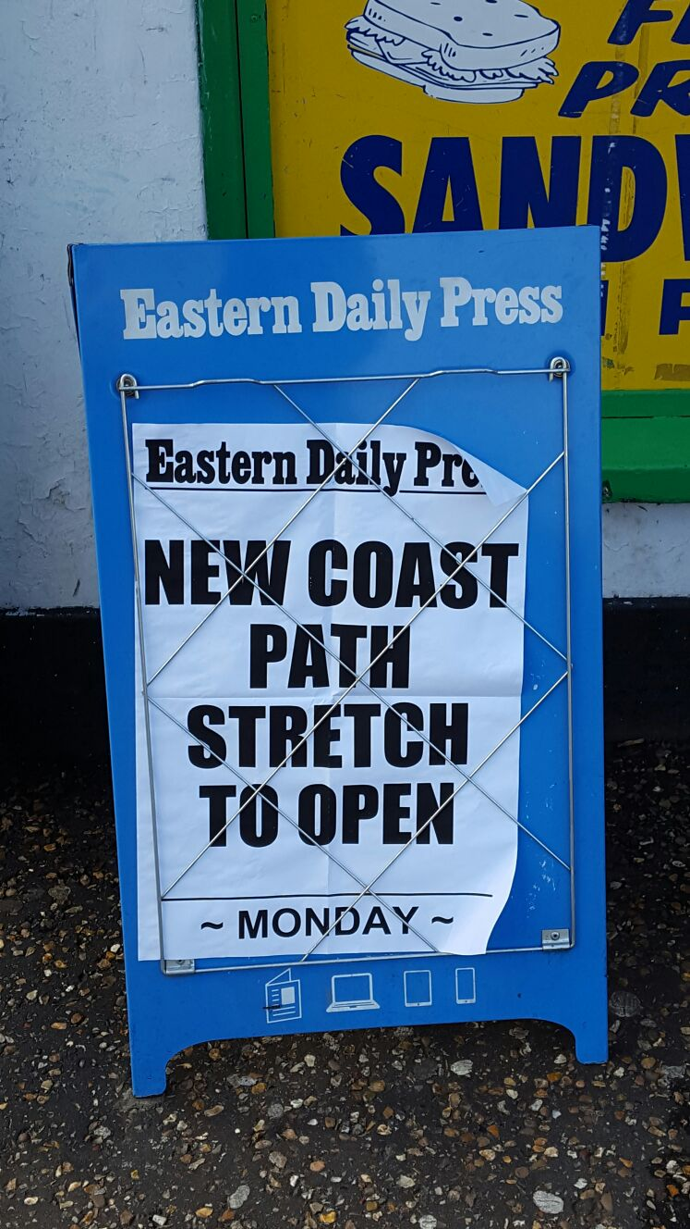
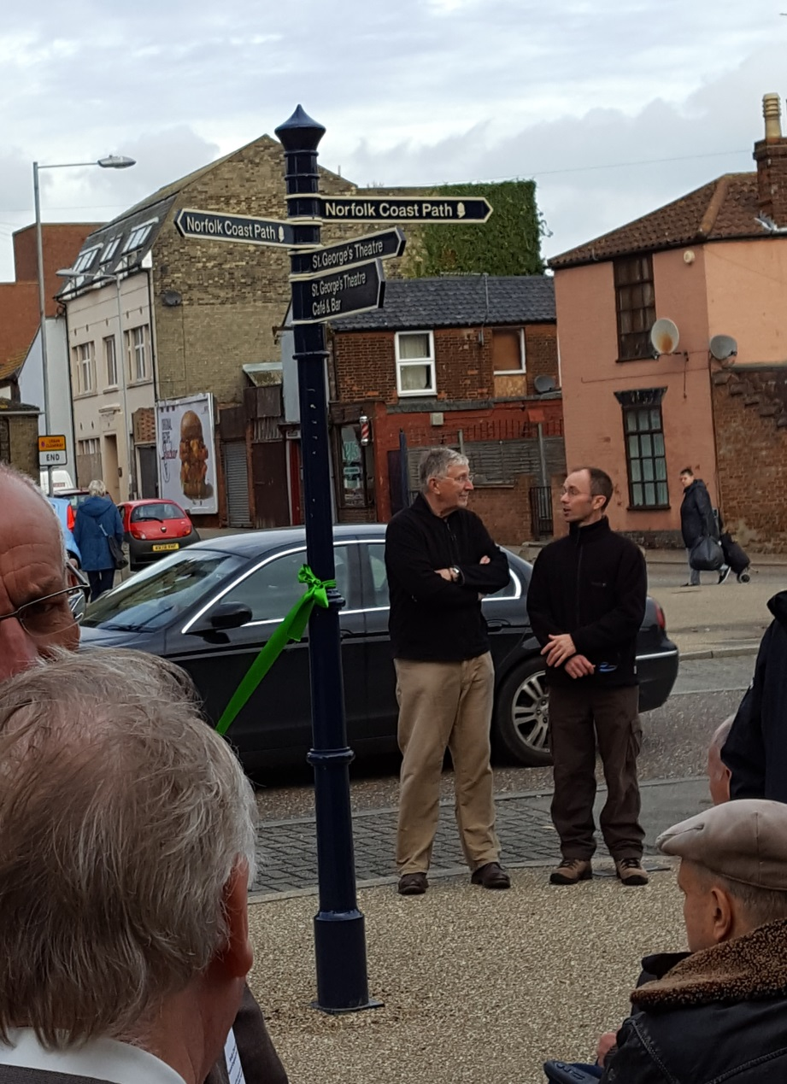
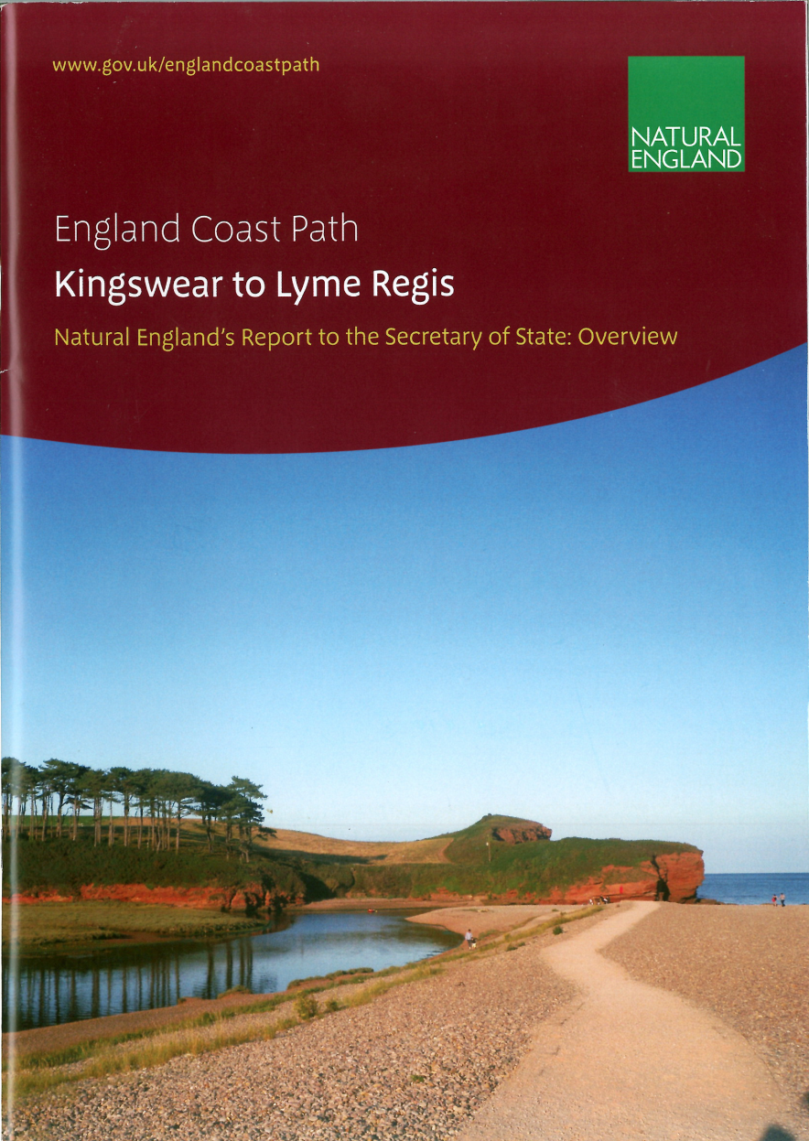
Making it happen
“One of the most ambitious ways we are opening up the natural world is through the England Coast Path. ”
Defra 25yr Plan
To date that’s
858 report maps
5,738 route sections
69,028 titles
All 66 stretches
in hand (and some completed)
2,706 miles
That’s all of the English coast

Slide 10
While the going can be a little tricky..
1,098 miles (31 stretches) have been submitted to government;
488 miles (16 stretches) have been approved;
358 miles (10 stretches) completed

Slide 11
What are the Benefits?
To date we have used data generated from
MENE
Welsh Coast Path
South West Cost Path
During 2017/18 we carried out the first baseline study of a National Trail
Visitor survey (>2000 @ 32 locations)
Automatic people counters
Secondary data sources (MENE, day visitor survey etc)

Slide 12
What are the Benefits?
Characteristics of people and their visits, to English coastal paths, in 2017:
29 million leisure walking trips
An additional £335 M spent in communities within 10 miles of path
£83 – the value to a person going for a walk on an English coastal path (£2.4 billion nationally)
11 fewer deaths (valued at £17m)
We need to repeat the study after the path is complete to assess the impact of ECP on delivering economic, health and social benefits

Slide 13
Questions?

